Slide 1

Digital Image Fundamentals
Digital Image processing
2.1 – 2.4
Jeong Ji Yeon
DGU_Vision_Seminar | jjy1000@dongguk.edu

Slide 2
2.1 Elements of Visual Perception
Digital image processing is built on a foundation of mathematical and probabilistic formulations.
Human intuition and analysis play an important role in choosing techniques, which are made by subjective visual judgment.
Visual Perception : The ability to understand visible light information entering the eye.
⇨ the mechanics and parameters related to how images are formed and perceived by humans.
DGU_Vision_Seminar | jjy1000@dongguk.edu

Slide 3
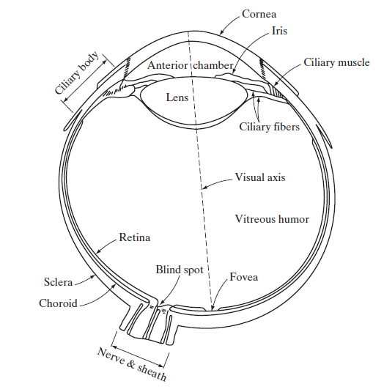
2.1.1 Structure of the Human eye
Three membranes enclose the eye: the cornea and sclera outer cover; the choroid; and the retina.
Retina
The innermost membrane of the eye.
Light from an object outside the eye is imaged on the retina.
Pattern vision is afforded by the distribution of discrete light receptors over the surface of the retina.
DGU_Vision_Seminar | jjy1000@dongguk.edu

Slide 4
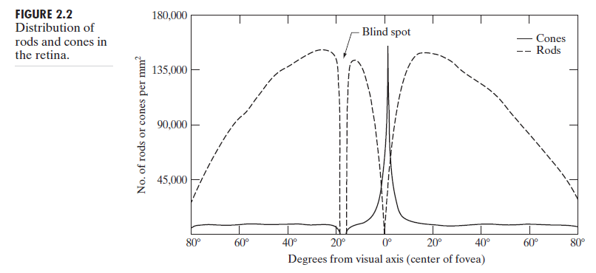
2.1.1 Structure of the Human eye
Retina - Receptors
There are two classes of receptors: cones and rods.
Cones : located in the central portion of the retina (-called the fovea). Highly sensitive to color. Humans can resolve fine details.
Cone vision is called photopic or bright-light vision.
Rods : serve to give a general, overall picture of the field of view. Not involved in color vision and are sensitive to low levels of illumination.
Rod vision is known as scotopic or dim-light vision.

Slide 5
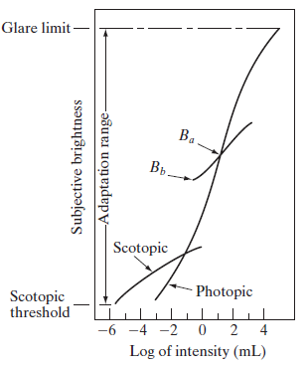
2.1.3 Brightness Adaptation and Discrimination
Digital images are displayed as a discrete set of intensities.
Subjective brightness
intensity as perceived by the human visual system.
logarithmic function of the light intensity incident on the eye
the visual system cannot operate over Adaptation range simultaneously.
Rather, it accomplishes this large variation by changing its overall sensitivity, a phenomenon known as brightness adaptation.
Ba : the current sensitivity level of the visual system - brightness adaptation level.
The short intersecting curve : the range of subjective brightness that the eye can perceive when adapted to this level.
Bb : In the range below the intersecting curve, all stimuli are perceived as indistinguishable blacks.

Slide 6
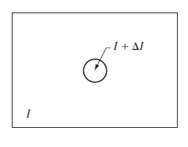
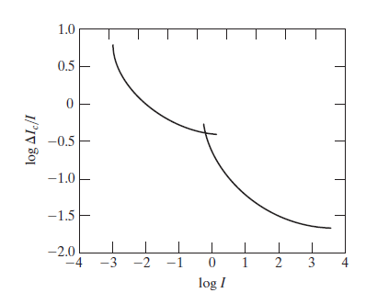
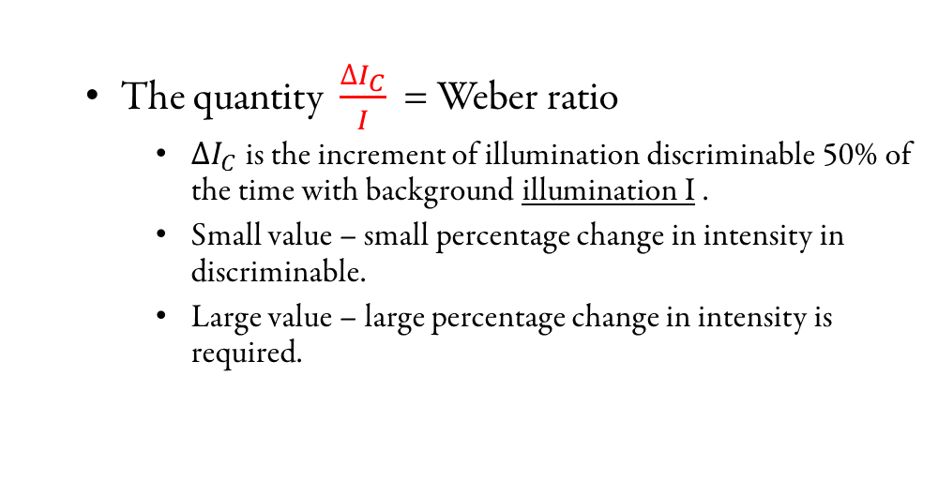
2.1.3 Brightness Adaptation and Discrimination
Classic experiment used to determine the capability of the human visual system for brightness.
The quantity $\frac{∆I_{C}}{I}$ = Weber ratio
$∆I_{C}$ is the increment of illumination discriminable 50% of the time with background illumination I .
Small value – small percentage change in intensity in discriminable.
Large value – large percentage change in intensity is required.
DGU_Vision_Seminar | jjy1000@dongguk.edu

Slide 7
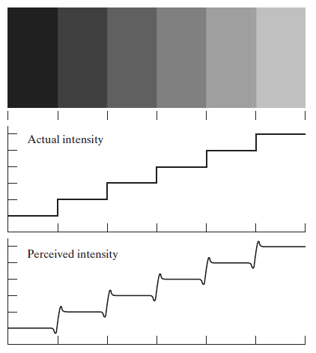
2.1.3 Brightness Adaptation and Discrimination
The eye is capable of a much broader range of overall intensity discrimination.
perceived brightness is not a simple function of intensity.
Mach bands
we perceive a brightness pattern that is strongly scalloped near the boundaries.
DGU_Vision_Seminar | jjy1000@dongguk.edu

Slide 8
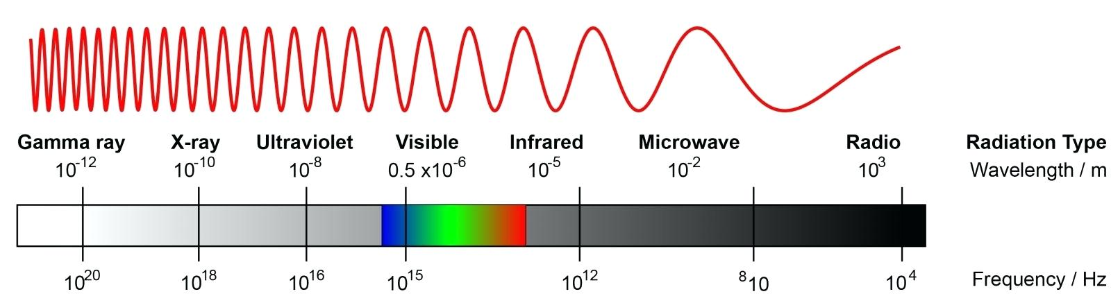
2.2 Light and the Electromagnetic Spectrum
The range of colors we perceive in visible light represents a very small portion of the EM spectrum.
The colors that humans perceive in an object are determined by the nature of the light reflected from the object.
A body that reflects light relatively balanced in all visible wavelengths appears white to the observer.
DGU_Vision_Seminar | jjy1000@dongguk.edu

Slide 9
2.2 Light and the Electromagnetic Spectrum
Monochromatic (or achromatic) light
attribute : intensity or amount
gray level : monochromatic intensity
The range of measured values of monochromatic light from black to white is usually called the gray scale, and monochromatic images are frequently referred to as gray-scale images.
Chromatic (color) light
Radiance [W] : the total amount of energy that flows from the light source.
Luminance [lm] : gives a measure of the amount of energy an observer perceives from a light source.
Brightness : a subjective descriptor of light perception that is practically impossible to measure.
DGU_Vision_Seminar | jjy1000@dongguk.edu

Slide 10
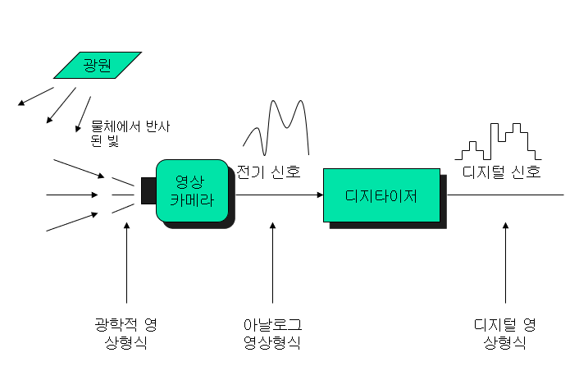
2.3 Image Sensing and Acquisition
Most of the images are generated by the combination of an “illumination” source and the reflection or absorption of energy from that source by the elements of the “scene” being imaged.
Incoming energy is transformed into a voltage by the combination of input electrical power and sensor material that is responsive to the particular type of energy being detected.
The output voltage waveform is the response of the sensor(s), and a digital quantity is obtained from each sensor by digitizing its response.
물체
DGU_Vision_Seminar | jjy1000@dongguk.edu

Slide 11
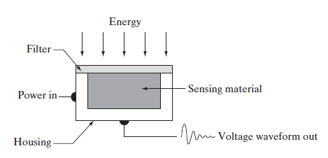
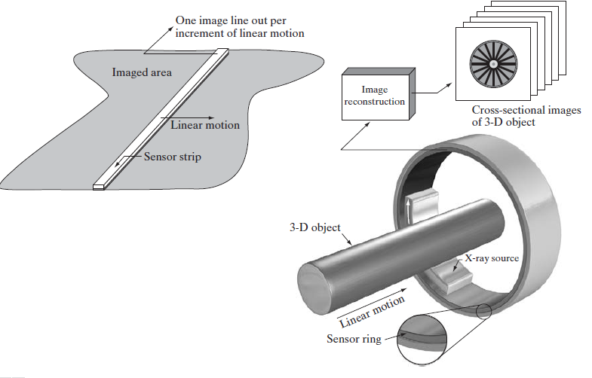
2.3 Image Sensing and Acquisition
1. Image Acquisition Using a Single Sensor
generate a 2-D image using a single sensor : relative displacements in both the x- and y-directions between the sensor and the area to be imaged.
2. Image Acquisition Using a Sensor Strips
In-line sensors : airborne imaging applications
Sensor strips mounted in a ring configuration : medical and industrial imaging
DGU_Vision_Seminar | jjy1000@dongguk.edu

Slide 12
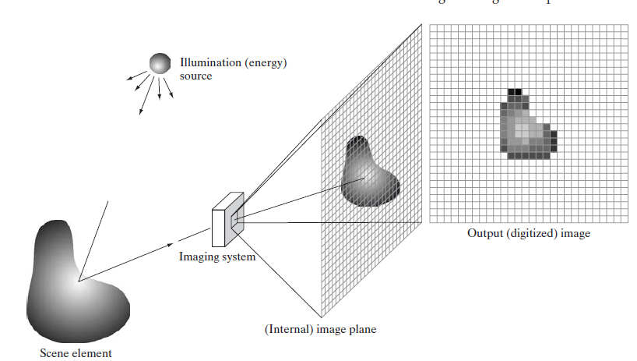
2.3 Image Sensing and Acquisition
3. Image Acquisition Using a Sensor Arrays
The sensor array is two-dimensional, its key advantage is that a complete image can be obtained by focusing the energy pattern onto the surface of the array. Motion obviously is not necessary.
DGU_Vision_Seminar | jjy1000@dongguk.edu

Slide 13






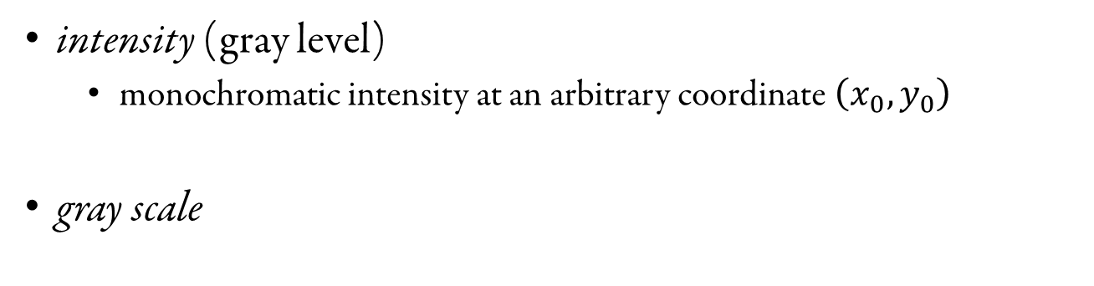
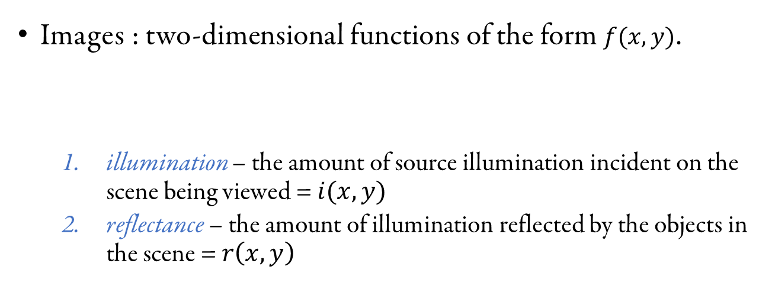
2.3.4 A Simple Image Formation Model
Images : two-dimensional functions of the form $f(x,y)$.
illumination – the amount of source illumination incident on the scene being viewed = $i(x,y)$
reflectance – the amount of illumination reflected by the objects in the scene = $r\left(x,y\right)$
intensity (gray level)
monochromatic intensity at an arbitrary coordinate $\left(x_{0}, y_{0}\right)$
gray scale
DGU_Vision_Seminar | jjy1000@dongguk.edu

Slide 14
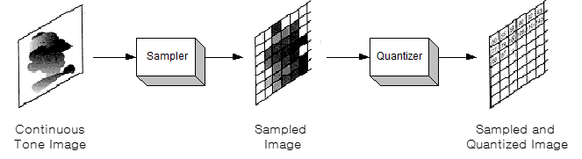
2.4 Image Sampling and Quantization
Objective : to generate digital images from sensed data
Sampling and Quantization
Digitizing the coordinate values(x, y) is called sampling. Digitizing the amplitude values is called quantization.
We take equally spaced samples along line AB. The samples are shown as small white squares superimposed on the function.
The values of the samples still span (vertically) a continuous range of intensity values.
Divide the brightness range by several discrete intervals, and assign the vertical proximity value in each sample. ⇨ Quantization
DGU_Vision_Seminar | jjy1000@dongguk.edu

Slide 15
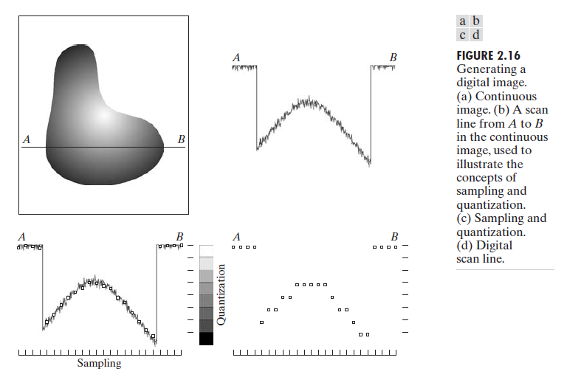
2.4 Image Sampling and Quantization
DGU_Vision_Seminar | jjy1000@dongguk.edu

Slide 16
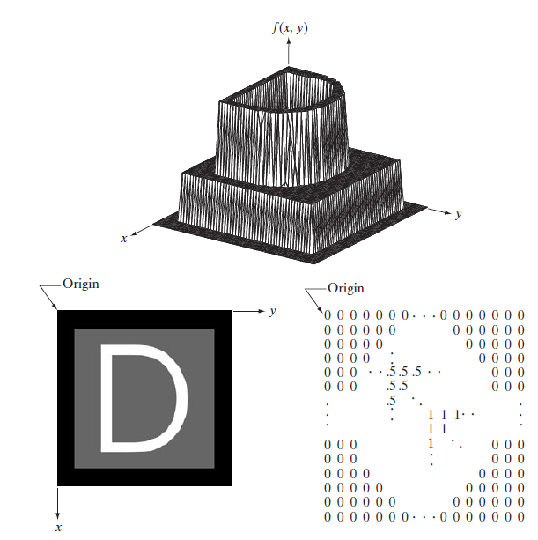
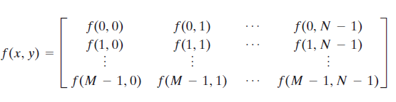

2.4 Image Sampling and Quantization
$f\left(s, t\right) : continuous image function of two continuous variables s and t$
Sample the continuous image into a 2-D array ($M×N$)
function : Image plotted as a surface
Image displayed as a visual intensity array
Image shown as a 2-D numerical array
$M×N$ numerical array
1.
3.
2.
pixel.
image element
DGU_Vision_Seminar | jjy1000@dongguk.edu

Slide 17


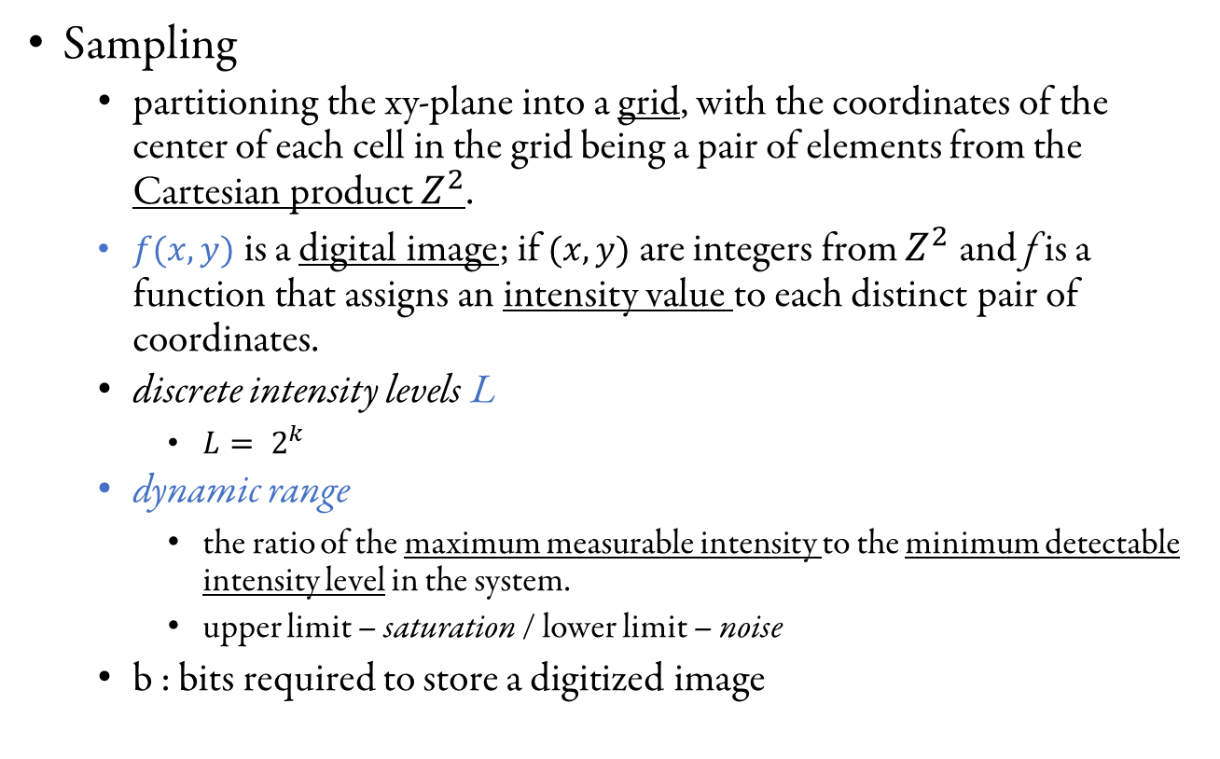
2.4 Image Sampling and Quantization
Sampling
partitioning the xy-plane into a grid, with the coordinates of the center of each cell in the grid being a pair of elements from the Cartesian product $Z^{2}$.
$f(x,y)$ is a digital image; if $(x,y)$ are integers from $Z^{2}$and f is a function that assigns an intensity value to each distinct pair of coordinates.
discrete intensity levels L
$L= 2^{k}$
dynamic range
the ratio of the maximum measurable intensity to the minimum detectable intensity level in the system.
upper limit – saturation / lower limit – noise
b : bits required to store a digitized image
DGU_Vision_Seminar | jjy1000@dongguk.edu

Slide 18
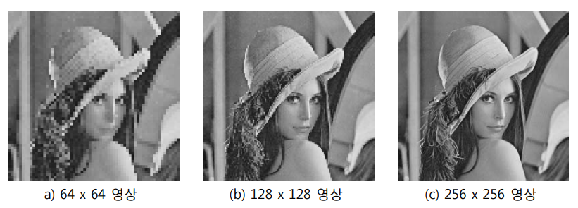
2.4.3 Spatial and Intensity Resolution
Spatial resolution
a measure of the smallest discernible detail in an image.
line pairs per unit distance, dots (pixels) per unit distance
definition : the largest number of discernible line pairs per unit distance
DGU_Vision_Seminar | jjy1000@dongguk.edu

Slide 19
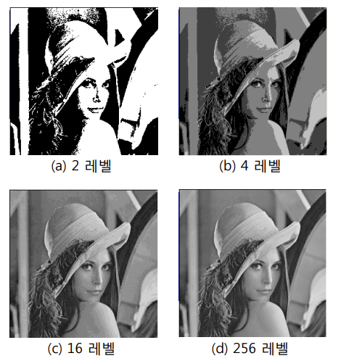
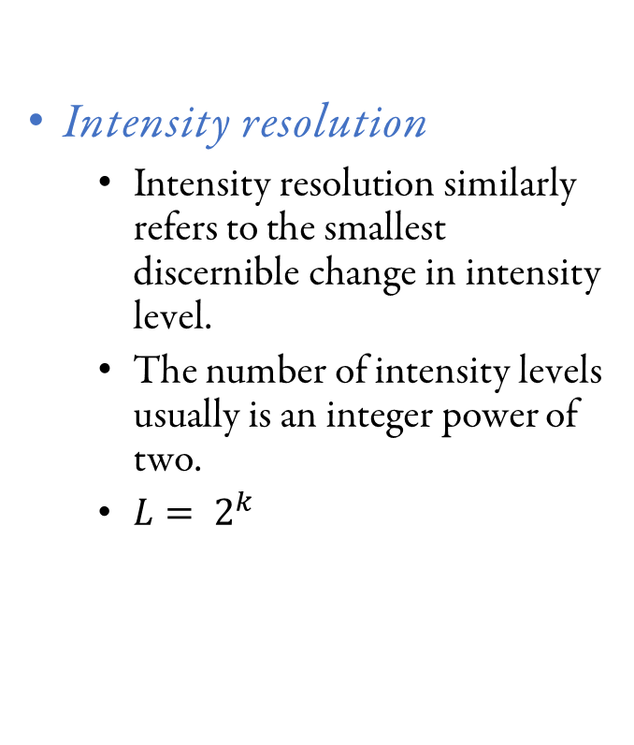
2.4.3 Spatial and Intensity Resolution
Intensity resolution
Intensity resolution similarly refers to the smallest discernible change in intensity level.
The number of intensity levels usually is an integer power of two.
$L= 2^{k}$
DGU_Vision_Seminar | jjy1000@dongguk.edu

Slide 20
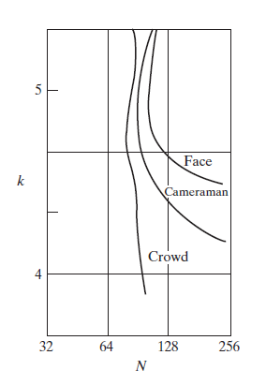
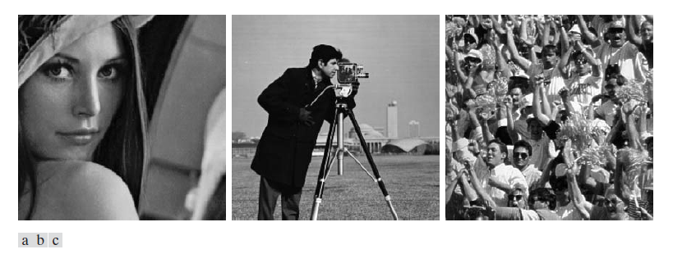
2.4.3 Spatial and Intensity Resolution
quantify experimentally the effects on image quality produced by varying N and k simultaneously
Results were summarized in the form of so-called isopreference curves in the Nk-plane.
DGU_Vision_Seminar | jjy1000@dongguk.edu

Slide 21
2.4.3 Spatial and Intensity Resolution
isopreference curves tend to become more vertical as the detail in the image increases.
for images with a large amount of detail only a few intensity levels may be needed.
fixed value of N, the perceived quality for this type of image is nearly independent of the number of intensity levels used
decrease in k tends to increase the apparent contrast, a visual effect that humans often perceive as improved quality in an image.
DGU_Vision_Seminar | jjy1000@dongguk.edu

Slide 22
2.4.4 Image Interpolation
Interpolation
a basic tool used extensively in tasks such as zooming, shrinking, rotating, and geometric corrections.
Apply it to image resizing (shrinking and zooming), which are basically image resampling methods.
The process of using known data to estimate values at unknown locations.
A simple way to visualize zooming is to create an imaginary grid with the same pixel spacing as the original, and then shrink it so that it fits exactly over the original image .
DGU_Vision_Seminar | jjy1000@dongguk.edu

Slide 23
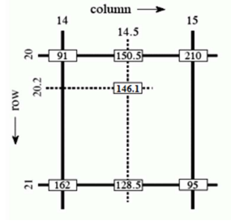
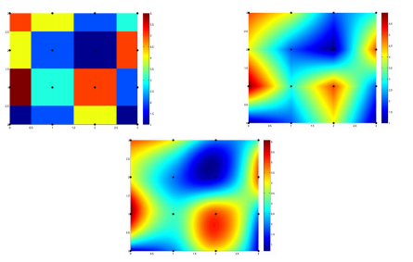

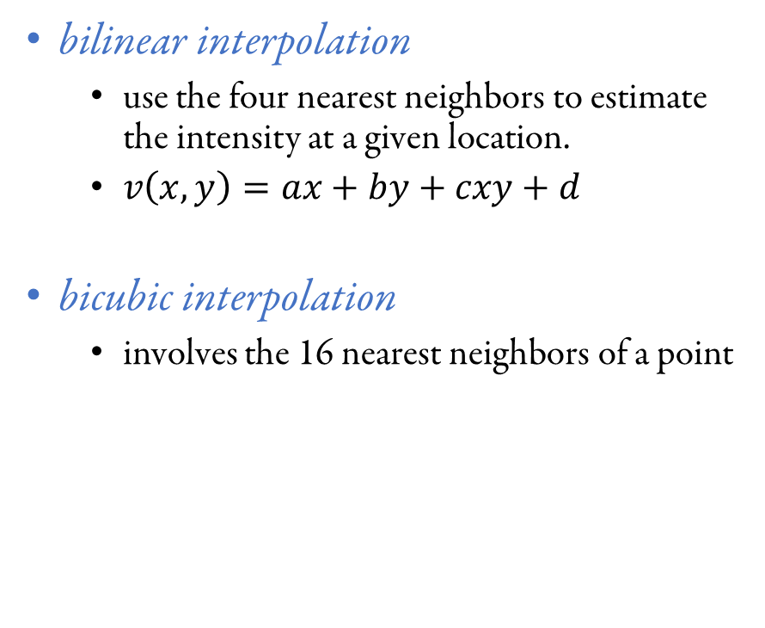
2.4.4 Image Interpolation
bilinear interpolation
use the four nearest neighbors to estimate the intensity at a given location.
$v\left(x,y\right)=ax+by+cxy+d$
bicubic interpolation
involves the 16 nearest neighbors of a point
DGU_Vision_Seminar | jjy1000@dongguk.edu

Slide 24
Thank you
DGU_Vision_Seminar | jjy1000@dongguk.edu

